Slide 1


NAME : ANUJ VERMA EMAIL ID : 2022BLAIML01@AXISCOLLEGES.IN AXIS INSTITUTE OF TECHNOLOGY AND MANAGEMENT ROOMA, KANPUR (UP) [ARTIFICIAL INTELLIGENCE] / [15/06/2023 – 07/07/2023]

Slide 2
PROJECT TITLE
PROJECT TITLE
MENTAL FITNESS TRACKER

Slide 3

PROBLEM STATEMENT
Mental health is an important issue in the world today. With a large population now working from home and staying away from loved ones, the mental health situation has deteriorated. As such, it becomes important to track and remedy any problems before they get too serious. We try achieving this using AI & ML.

Slide 4
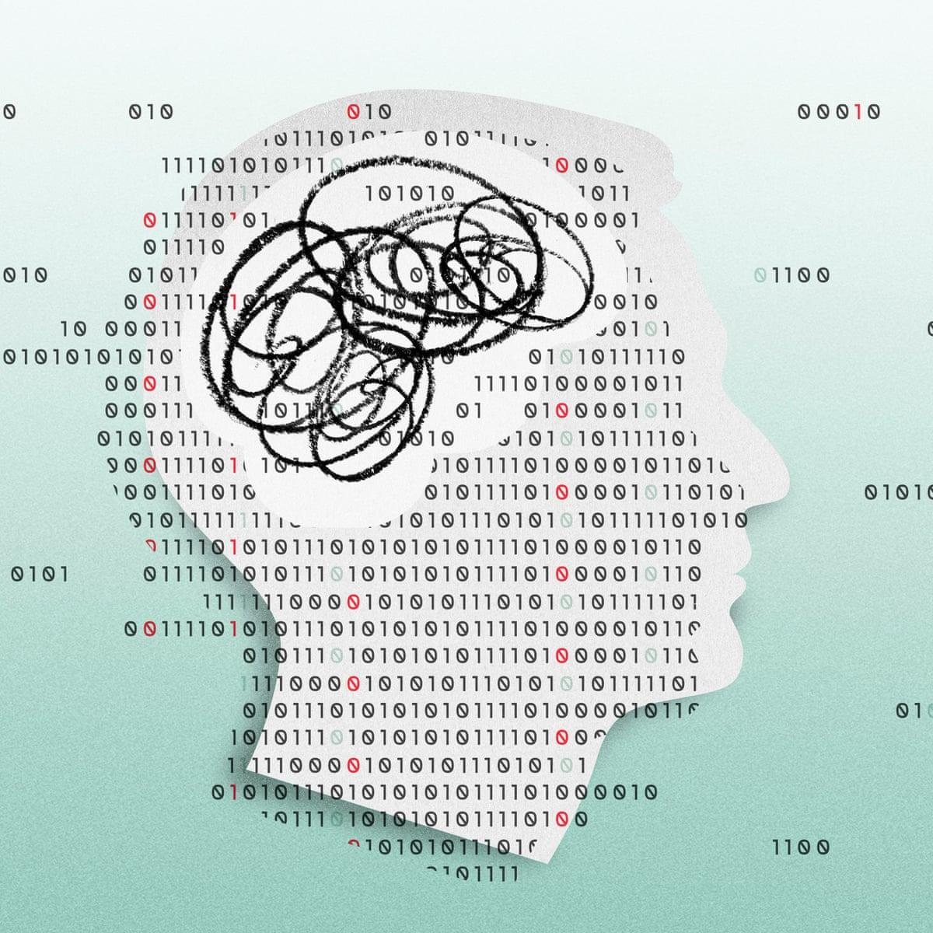
AGENDA
Maintaining good mental fitness is crucial for overall well-being. The AI and ML mental fitness tracker offers a unique opportunity to monitor and improve our mental health. With its advanced algorithms, it can identify patterns, provide personalized recommendations, and help us take proactive steps towards achieving optimal cognitive well-being. Let's delve deeper into the significance of mental fitness and how the AI and ML tracker can revolutionize our approach to it.

Slide 5

PROJECT OVERVIEW
The AI Mental Fitness Tracker is a project that utilizes Python and its libraries to create a tool for monitoring and enhancing mental well-being. It combines the power of artificial intelligence and data analysis to track and analyze various aspects of mental fitness. The project aims to provide users with insights into their mental health and offer personalized recommendations for improving their well-being.

Slide 6

WHO ARE THE END USERS OF THIS PROJECT?
The end users of this project can be individuals who are interested in monitoring and improving their mental fitness. This can include anyone who wants to track their emotions, stress levels, sleep patterns, or overall mental well-being. It can be useful for individuals experiencing stress, anxiety, or other mental health concerns, as well as those who simply want to maintain a healthy mindset.

Slide 7

YOUR SOLUTION AND ITS VALUE PROPOSITION
The AI Mental Fitness Tracker offers several key features and benefits. It uses advanced data analysis techniques to process the provided datasets, providing visualizations, trends, and statistical insights related to mental of mental and substance use disorders health and substance use disorders. Users can track the prevalence time, observe their share of overall disease burden, and gain valuable information for research, policymaking, and personal mental health management.

Slide 8
HOW DID YOU CUSTOMIZE THE PROJECT AND MAKE IT YOUR OWN
To make the project unique and customized, several enhancements were made:
Integration of Datasets: The project incorporates the prevalence-by-mental-and-substance-use-disorder dataset, enabling a comprehensive analysis of mental health. By utilizing the mental-and-substance-use-as-share-of-disease dataset, the system can provide a broader perspective on the impact of mental health on overall well-being.
Machine Learning Algorithms: The project employs advanced machine learning techniques to identify patterns, trends, and anomalies in mental health data, enhancing the accuracy of the assessments and recommendations provided.

Slide 9
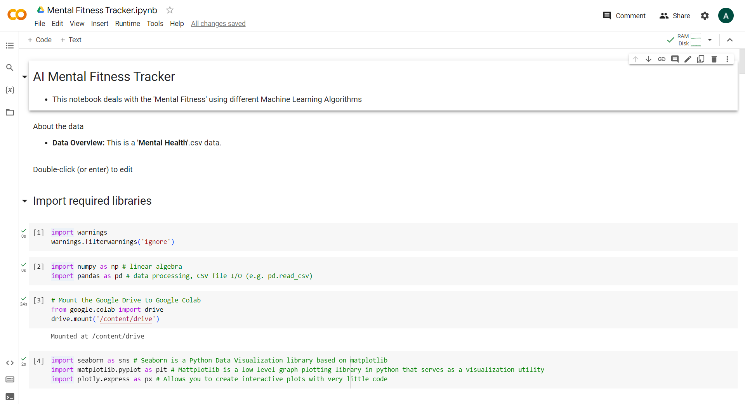
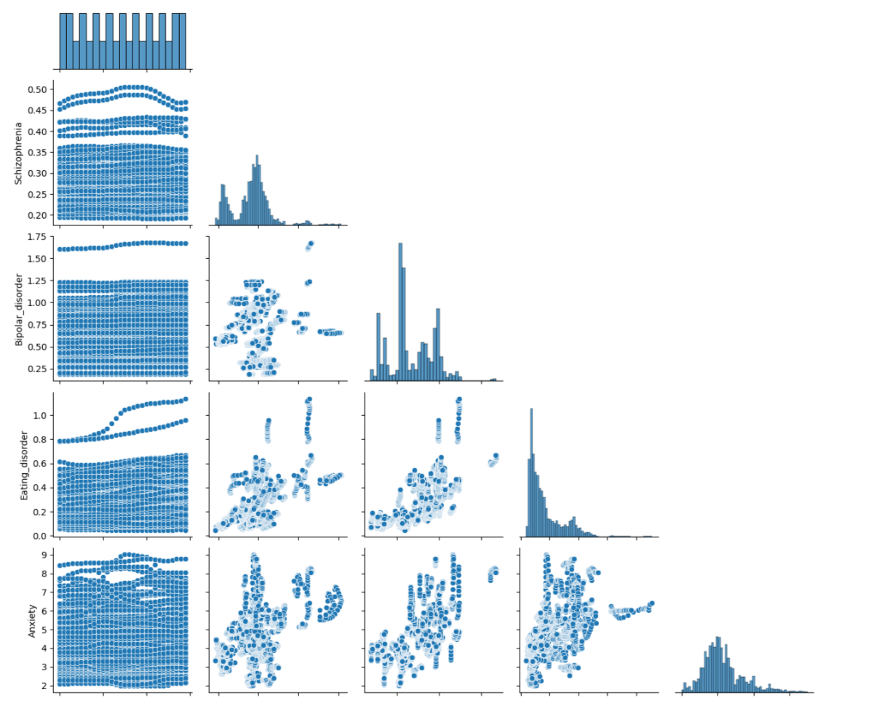
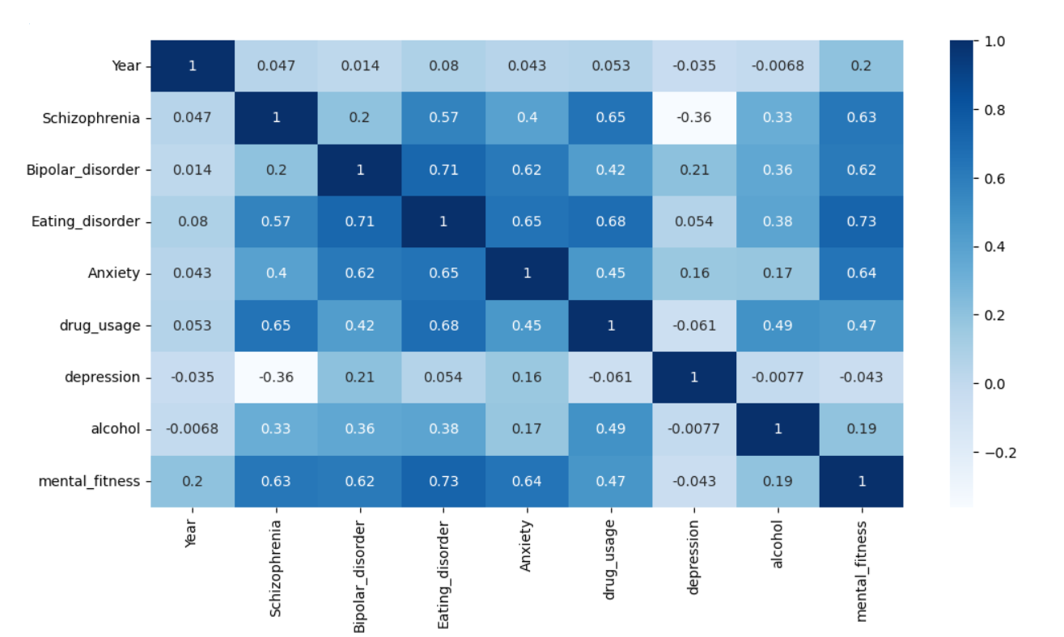
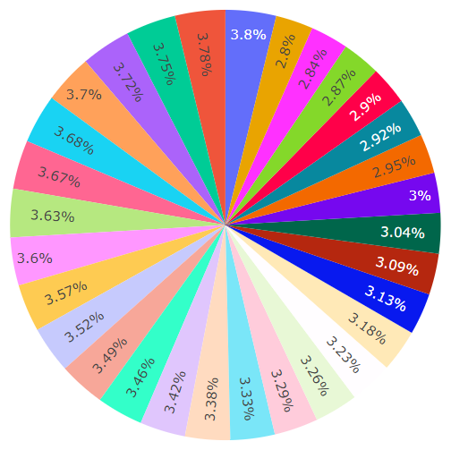
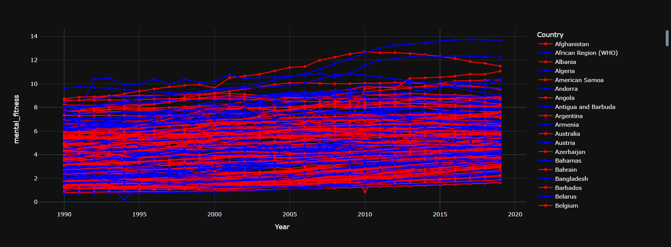
MODELLING

Slide 10

RESULTS
AI Mental Fitness Tracker project using the prevalence-by-mental-and-substance-use-disorder and mental-and-substance-use-as-share-of-disease datasets, along with Python libraries, provides valuable results in terms of accurate assessments, personalized recommendations, real-time monitoring, progress tracking, early warnings, and improved mental well-being.
By personalizing the project with these enhancements, the AI Mental Fitness Tracker becomes a valuable tool for individuals and mental health professionals alike, promoting proactive mental well-being management and early intervention, ultimately improving overall mental health outcomes.

Slide 11

LINKS
Code:
https://colab.research.google.com/drive/1ssigguPwEsx7rUpKy78SlIrQZhjo2auT?usp=sharing
Data Set :
https://drive.google.com/drive/folders/1LUutqNYREffYB9h5NmF9aFpxopbgzs3G?usp=drive_link

